Slide 1
Human wellbeing
Year 10 geography

Slide 2
Definition – Human wellbeing
Combination of physical, emotional, social, economic, environmental and political factors that vary between people and places.

Slide 3
Definition - development
A process of change that improves the quality of life of a community.

Slide 4
Developing COUNTRY V DEVELOPED COUNTRY
Developed Country – a rich, industrialised country of the world. Sometimes referred to as ‘MDC’s or More Developed Countries.
EXAMPLES: USA, Japan, Australia and South Korea
Developing Country – a poor or middle – income country often dependent on subsistence farming. Sometimes referred to as ‘LDC’s or Less Developed Countries.
EXAMPLES: Including countries located in the continent of Africa, such as Kenya, Mozambique and Ethiopia.

Slide 5

MEASURING & MAPPING – HUMAN WELLBEING
Human wellbeing can be measured using qualitative (subjective) measures of how people perceive the quality of life they experience, or quantitative (objective) measures, for example income, education levels and life expectancy.

Slide 6

Qualitative indicators
Qualitative or subjective indicators
Indicators of human wellbeing are those aspects of standard of living that are difficult to measure
Examples include – political freedoms, personal security and safety and social opportunities.
Qualitative → Quality

Slide 7
Quantitative indicators
Quantitative indicators are objective and measurable.
Typically take the form of numbers, data or an index score
Examples include – Gross National Product (GNP), Gross Domestic Product (GDP)
Quantitative → Quantity

Slide 8
Spatial patterns and indicators
Spatial patterns emerge when qualitative and quantitative indicators of human wellbeing are m______________.
Spatial patterns, reasons for patterns and ways in which patterns change over time can be studied by a geographer.

Slide 9
Spatial patterns and indicators
Spatial patterns emerge when qualitative and quantitative indicators of human wellbeing are mapped.
Spatial patterns, reasons for patterns and ways in which patterns change over time can be studied by a geographer.

Slide 10
Economic & social development– types of indicators
Economic indicators:
An economic indicator of development is a measure of a country’s e____________ and w_________.
Example: Gross National Product (GNP)

Slide 11
Economic & social development– types of indicators
Economic indicators:
An economic indicator of development is a measure of a country’s economy and wealth.
Example: Gross National Product (GNP)

Slide 12
Economic & social development– types of indicators
Human or Social Indicators:
A human or social indicator of development is a measure of development based on health, welfare and education of the people in a country.
Example: Infant mortality, literacy rate

Slide 13


COMPARING DATA - PNG V AUSTRALIA
CATEGORY | Papua New Guinea (PNG) | Australia
Population | 7.2 million | 23 million
Urban Population | 13% | 89%
HDI (2015) | 154/188 | 2/188
Life Expectancy at birth | 62.8 years | 82.5 years
Mean years of schooling | 4.3 years | 13.2 years
Gross National Income per capita | $2,712 | $42,822
Under-five mortality rate (per 1000 live births) | 68 | 5

Slide 14
PAPUA NEW GUINEA
Papua New Guinea – A few facts
Approximately 30% of children never attend Primary school
Historical links and geographical proximity to Australia.
People in remote areas have poor access to clean drinking water and adequate sanitation.
PNG has approximately one doctor for every 17, 068 people, compared to one doctor for approximately every 302 people in Australia (2013 data)
People must travel (walk) long distances to reach a medical centre and get to school (education).
Approximately 7.9% of the population have the internet.
Increasing efforts to improve teacher training.
PNG did not achieve any of the eight MDG’s by 2015.
PNG is the second-largest recipient of Australian aid
PNG is ranked 150th out of 176 countries on the International Corruption Index, which makes aid less effective.

Slide 15

The Human Development Index (HDI)
…is the best known index of social and economic well-being…
It is a composite index, meaning that it’s made up of more than one indicator.
UNDP stands for United Nations Development Program

Slide 16

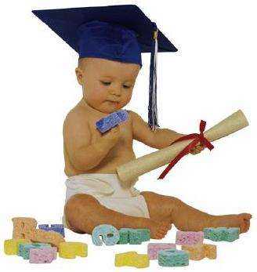
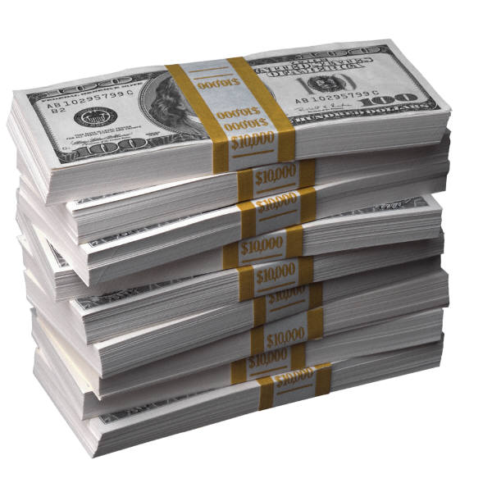
How the UNDP Measures Human Development
Consists of 3 equally weighted components:
(1) “A long and healthy life” (Health)
(2) “Knowledge” (Education)
(3) “A decent standard of living” (Wealth)
Notes:
Questions to ask: Do you think the combination of “health,” “education,” and “wealth” adequately measures “human development”? Why or why not?
What other measures of “human development” might you include if you were to create your own human development index (e.g., environment, leisure, happiness, etc.)?

Slide 17


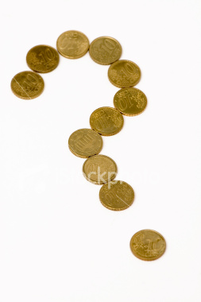
Deconstructing Each Measure
Each component of the HDI is measured in the following way:
Health- Measured by life expectancy at birth.
Education - Measured as a combination of adult literacy (worth 2/3) and enrollment in school (worth 1/3).
Wealth - Measured by GDP per capita.
Notes:
Is “life expectancy at birth” a good measure of health? Why or why not? Can you think of other ways to measure “health” that might bring about different results (e.g., obesity rates, infant mortality rate, etc.)?
Is the combination of “adult literacy” and “gross enrollment” a good measure of “education”? Why or why not? Can you think of other ways to measure “education” that might bring about different results (e.g., percent in college, test scores, etc.)?
Is “GDP per capita” a good measure of “wealth”? Why or why not? Can you think of other ways to measure “wealth” that might bring about different results (e.g., income inequality, poverty rates, etc.)?

Slide 18
Human development index
HDI is a single statistic that measures l_____ e__________, y_________ of s_________ and G______ D__________ P__________ per capita.
It covers approximately 185 countries., scoring them from 0 (the lowest HDI) to 10 (the highest HDI).
Countries are classified into very high, high, medium, low and very low human development.
Very high to high HDI accounts for 30% of the world’s population, medium 52% and low ___%.
The HDI provides international organisations such as the U__________ N_________, governments and non-government organisations, such as World Vision with an indication of support countries need.

Slide 19
Human development index
HDI is a single statistic that measures life expectancy, years of schooling and Gross Domestic Product per capita.
It covers approximately 185 countries., scoring them from 0 (the lowest HDI) to 10 (the highest HDI).
Countries are classified into very high, high, medium, low and very low human development.
Very high to high HDI accounts for 30% of the world’s population, medium 52% and low 18%.
The HDI provides international organisations such as the United Nations, governments and non-government organisations, such as World Vision with an indication of support countries need.

Slide 20
Understanding Indexes
What is an index?
It’s a collection of stuff that you measured so that you can compare it to something.
An index is a composite of indicators that produces a single calculation which can then be ranked.

Slide 21
Economic & Social Indexes
Economic indicators and indexes (that deal with money) are put together with social indexes and indicators (that deal with people) are put together to assess WELLBEING.

Slide 22
Summary – quantitative indicators
Gross National Product per capita
Composite quantitative measures such as Human Development Index, Multidimensional Poverty Index and Gender-Related Development Index.

Slide 23
Causes of spatial inequality – external factors
Legacy of history – many of the world’s poorest countries were in the past colonies of vast European empires. Legacy of colonialism.
Colonialism – the practice of acquiring full or partial control over another country, occupying it and exploiting it economically.
Trade imbalances – Many poor (developing) countries are still dependent on the industrialised, wealthy countries for many imported goods (high cost). Many people in developing countries have been encouraged to change from subsistence production to the production of cash crops, such as coffee and tea.
Transnational Corporations – TNC’s frequently operate headquarters in developed countries and subsidiary companies in developing countries. These countries are attractive as they may offer lower cost inputs, available and cheaper raw materials, plus cheaper labour… Goods produced in developing countries are then sold to consumers in developed countries.

Slide 24
Causes of spatial inequality – external factors
Dependency on development assistance – Many developing or poor countries are heavily dependent on development assistance
Three major types of aid:
Bilateral aid – government of wealthy countries providing assistance to developing countries.
Multilateral aid – provided by international institutions such as World Bank, International Monetary Fund (IMF) (often provided in loans)
Non- Governmental Aid – provided by NGO’s (Non-Government Organisations) (income from donations from people)

Slide 25
Causes of spatial inequality – internal factors – Discuss
Population growth
Resource base
Political instability
Debt burdens
Militarisation
Environmental degradation
Compounding issues

Slide 26
HUMAN WELLBEING - ISSUES
Ask students to work with a partner to discuss the following…
What are some of the barriers to improving human wellbeing?

Slide 27
HUMAN WELLBEING - ISSUES
Low life expectancy
Low access to health services
High maternal mortality rates
High infant mortality rates
Relatively high levels of illiteracy
Lack of adequate shelter
Low income per capita
Poverty
Lack of access to clean water and sanitation
Dietary deficiencies
Child exploitation
Rural-urban inequality
Low levels of technology
Lack of commitment to environmental sustainability
High rates of population growth
Indebtedness
Low levels of energy consumption – access to electricity.

Slide 28
GOALS
The millennium development goals
Sustainable development goals
In 2000, 189 countries agreed to improve human wellbeing of the world and came together at the United Nations and agreed on eight goals to halve extreme poverty by 2015.
The goals were called the Millennium Development Goals (MDG’s)
Over 15 years, much was achieved
Examples of Goals –
Goal 1: Eradicate extreme poverty and hunger
Goal 4: Reduce Child Mortality
Goal 6: Combat HIV and AIDS, malaria and other diseases.
A meeting of the United Nations in 2015, representatives of all 193 member countries present agreed to set goals to protect the planet, ensure that all people on earth enjoy a high level of wellbeing by 2030 and designed to end poverty.
17 goals created and agreed on.
Seven of the 17 goals related directly to reducing inequalities in human wellbeing.
Examples of these 7 goals –
Goal 1: End poverty in all its forms, everywhere.
Goal 2: End hunger, achieve food security and improved nutrition and promote sustainable agriculture.
Goal 3: Ensure healthy lives and promote wellbeing for all at all ages.
Goal 4, Goal 5, Goal 6 and Goal 10 all relate to inequalities in human wellbeing.

Slide 29
Riq – 321 (Topic: The PowerPoint)
3 recalls/remember
2 insights/interesting
1 question

